Slide 1
A New Surface Wave Coupling Scheme for the COARE Air-Sea Flux Algorithm C.W. Fairall¹, M. Banner², and R. Morison² AGU December 2017
Background
The wave model
HIWINGS field program
Summary

Slide 2
Background
Climate/Weather models are sensitive to representation of surface fluxes
Basic Meteorological Direct fluxes:
Sensible Heat, H_{s}
Latent Heat, H_{l}
Momentum, τ
At High Winds Wave Breaking Relevant
Sea spray, gas transfer, drag coefficient, wave dissipation
Wave parameters
Phase speed (Cp), height, swell vs seas, Wave age=Cp/U10
Whitecap fraction, MSS, energy dissipation

Slide 3
Present Status of Turbulent Surface Flux Parameterizations
Turbulent Fluxes: Bulk Parameterization
Mean correlation of turbulent variables represented in terms of mean flow variables – wind speed, surface-to-air variable difference
MetFlux – Dominated by atmospheric turbulent xfer
GasFlux – Dominated by oceanic molecular xfer;
Enhanced by whitecap bubbles
Second-order effects: stability, cool-skin and warm-layer SST, gustiness, waves?

Slide 4
COARE Algorithms History
Table 2. History of the COARE bulk algorithms.
Year | Version and Function | Collaborators
1996 | 2.5 Met fluxes, cool skin, diurnal warm layer | UConn, CSIRO
2000 | CO2 | UConn, LDEO, WHOI
2003 | 3.0 Met fluxes | UConn, CSIRO
2004 | DMS | UHawaii
2005 | Snow and Ice | CRREL
2006 | Ozone | UColo INSTAR
2008 | PCB and PCE | Mich. Tech. U.
2011 | 3.1G Gas fluxes: CO2, CO, O3, DMS, He, SF6 | UConn, LDEO, UHawaii, UColo INSTAR
2013 | 3.5 Met fluxes | UConn, WHOI, SUNY, OSU
2017 | 3.6 Met, 3.6G Gas, 3.6I Ice-air-water fluxes | UConn, UNSW, LDEO
Algorithms and updates: 11 pubs

Slide 5
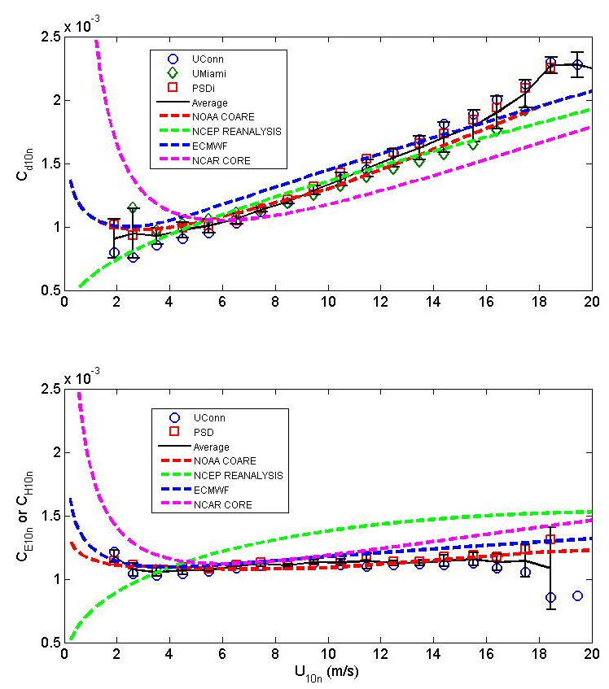
2011 Synthesis On Transfer Coefficient Direct Measurements: Combined Observations from NOAA, UConn, UMiami
Neutral turbulent transfer coefficients at z=10 m as a function of wind.
Symbols are Direct Data (14,450 observations; 90% between 3 and 17 m/s)
Dash Lines are Parameterizations
*Observations of 3 Research Groups Agree Closely ( with 5%) But Need More High Speed Data
*Spread of Parameterizations is Greater Than Spread of Observations
Uconn - C_{H}
PSD - C_{E}

Slide 6
NOAA COARE Gas Transfer Algorithm: COARE Turbulent-Molecular Physics and Woolf Bubble Physics
Bubbles enhance transfer on ocean side
Atmos Resistance
Ocean Resistance
A is adjustable constant, phi an ocean buoyancy function
Woolf bubble xfer velocity B is adjustable constant
W is whitecap fraction
u_{*a} from COARE3.0 bulk flux algorithm:
Windspeed or wave-based u* relationships

Slide 7
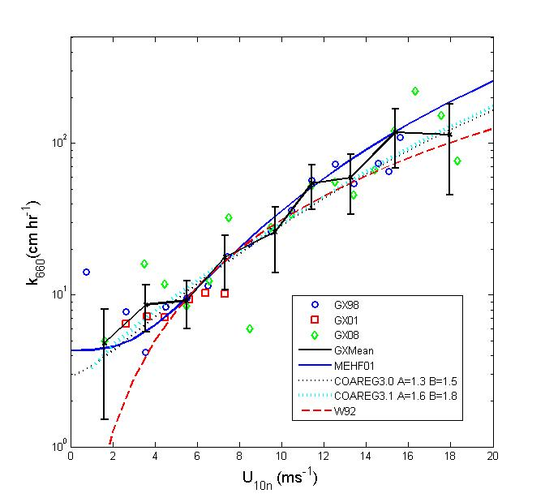
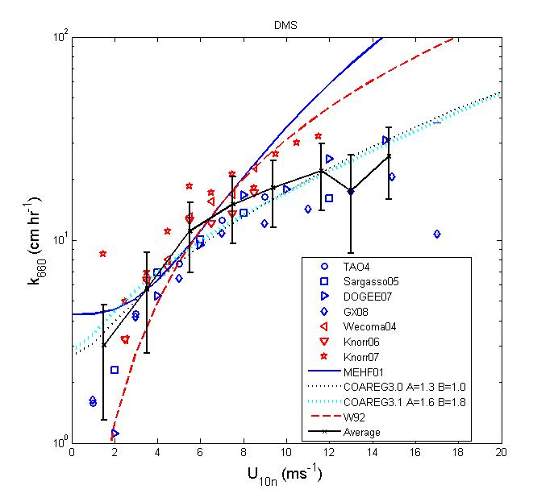
Summary Plots of CO2 and DMS Transfer Velocity Observations as of 2011
Because DMS is more soluble, the bubble contribution is much lower than CO2

Slide 8
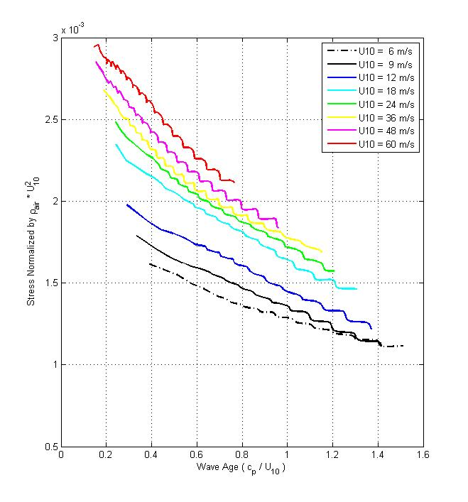
It’s Complicated: Banner & Morison Wave Model

Slide 9
Why Use a Model?
Many details that are difficult to observe
Wind-wave parameters are highly correlated, so difficult to separate physics in observations
‘Extrapolate’ to higher wind speeds

Slide 10
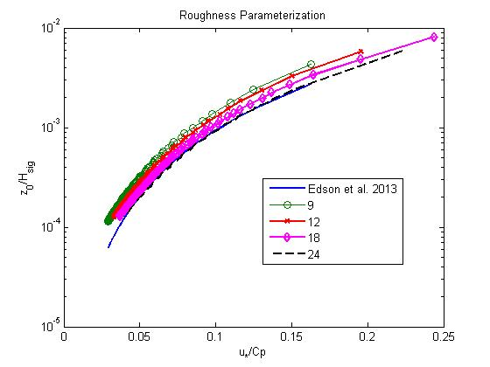
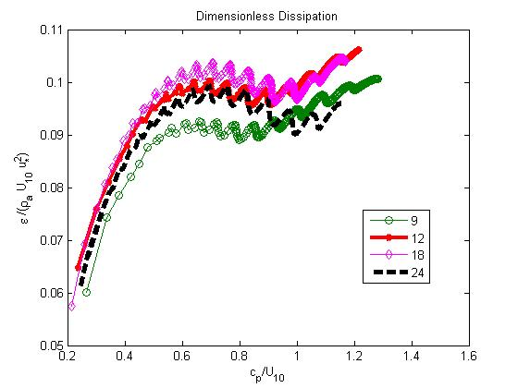
UNSW Wave Model Example Results
U10=30 m/s
Roughness Parameterization
Energy dissipation by wave breaking

Slide 11
COARE3.6
Default=No Wave Information
Uses U-based C_{d}, etc
COAREG uses U-based whitecap from wave model – better than old U^3.4 dependence
Wave information: C_{p}, H_{s}
If C_{p} is known but H_{s} is not, uses H_{s}(U,C_{p})
Wave-based parameterizations for C_{d}, C_{E}, whitecaps, dissipation, MSS
Outputs
u*, H_{s}, H_{l}, k_{x}, whitecap, MSS, Ediss

Slide 12
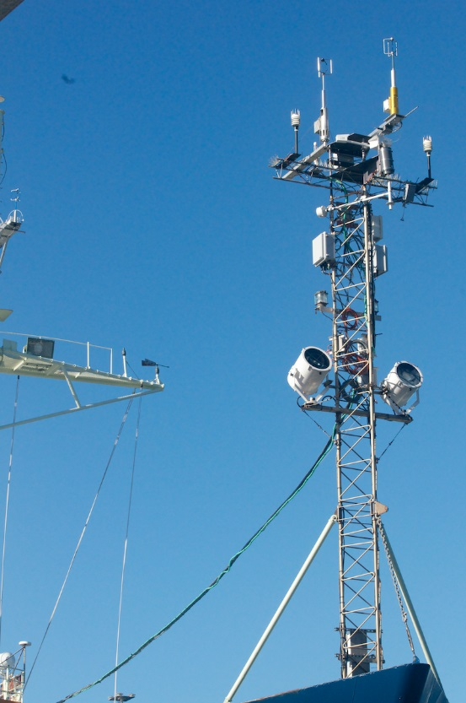
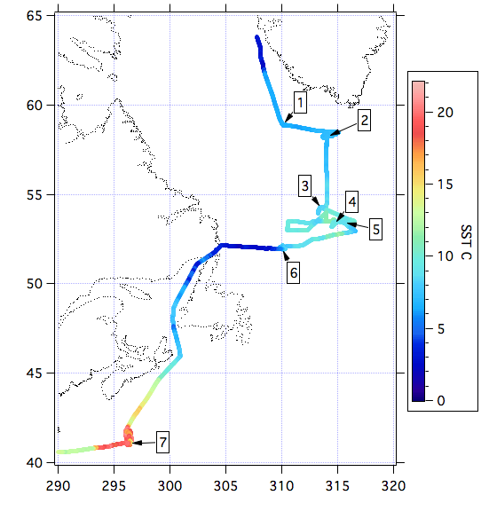
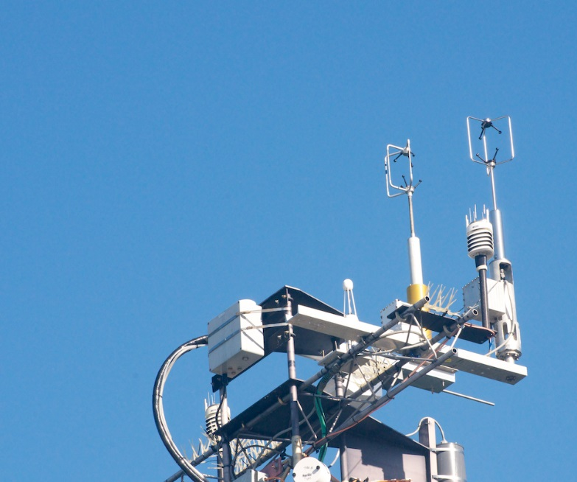
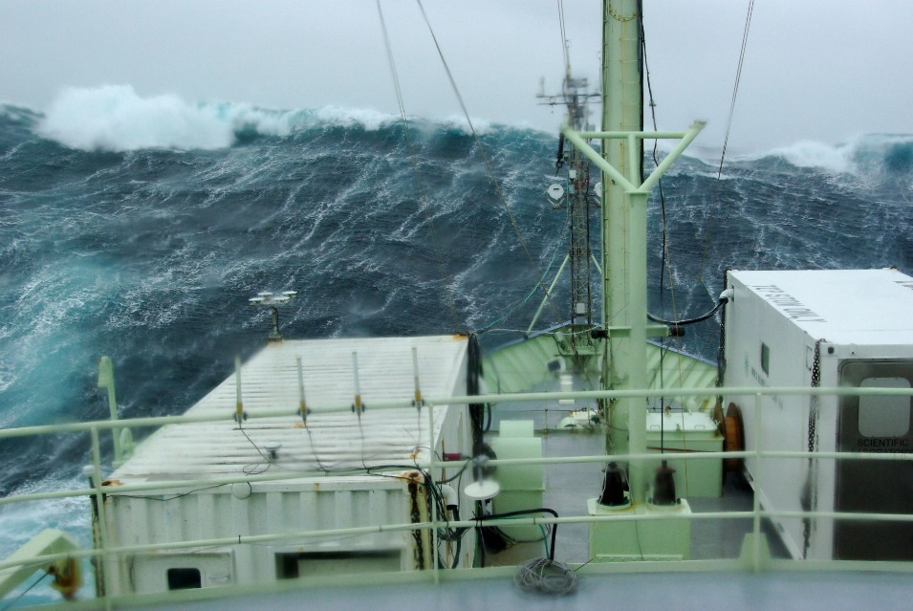
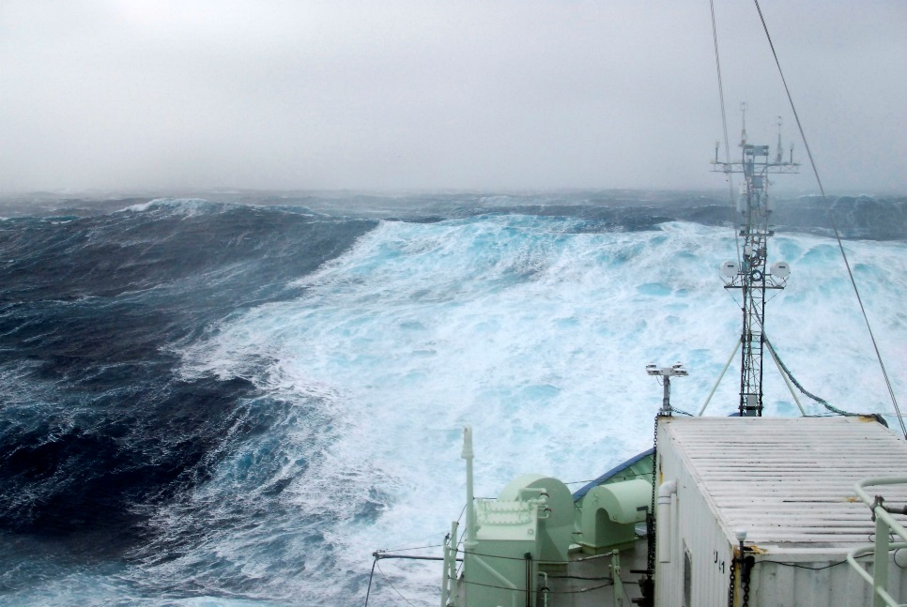
HIWINGS 2015

Slide 13
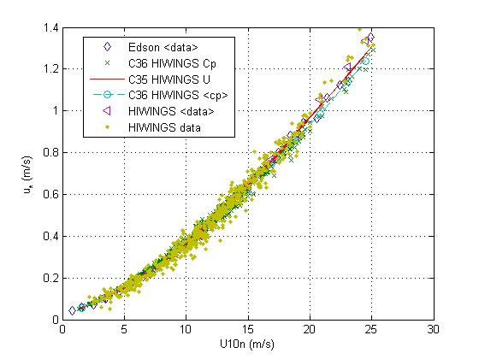
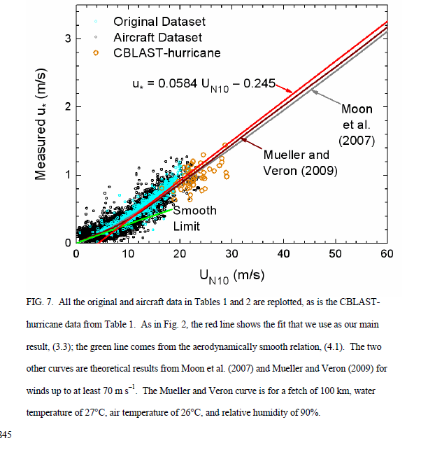
Progress on Flux Measurements: Historical vs HIWINGS
Cyan – Ship database
Black – Mahrt Aircraft database
Orange – CBLAST aircraft
PSD Observations from HIWINGS
Big symbols – averages in windspeed bins
Red line – C35 Cd(U)
X’s – Cd(U, Cp, Hs)
Green dots – One hr u* observations

Slide 14
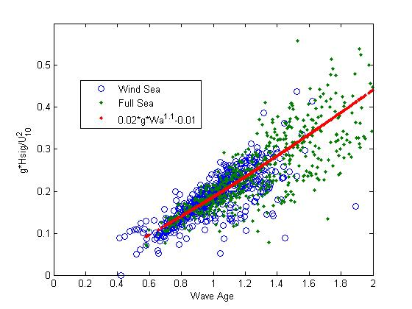
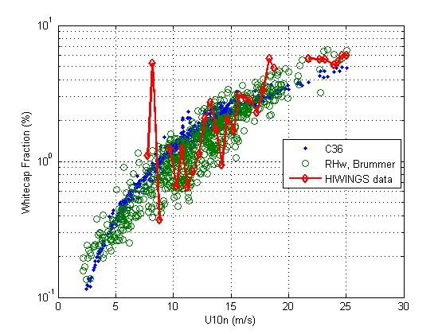
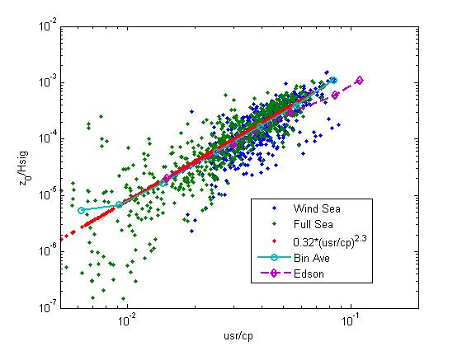
HIWINGS Examples

Slide 15
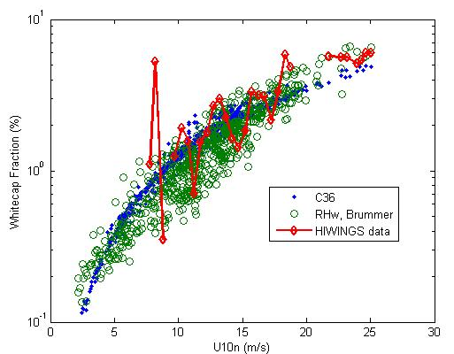
Does It Work? Results from HIWINGS
Friction Velocity
Whitecap Fraction
*Cd(U) gives slightly better RMS that Cd(wave). So far, wave info does not reduce RMS about Cd(U) – doesn’t seem to add anything.
*Wave breaking more important for gas transfer, sea spray aerosol generation, and hurricane sea spray effects. Whitecap fraction, energy flux ≈ wave energy dissipation
*Whitecaps, Ediss, bubbles are all observational problems, especially sampling. NEED airborne methods.

Slide 16
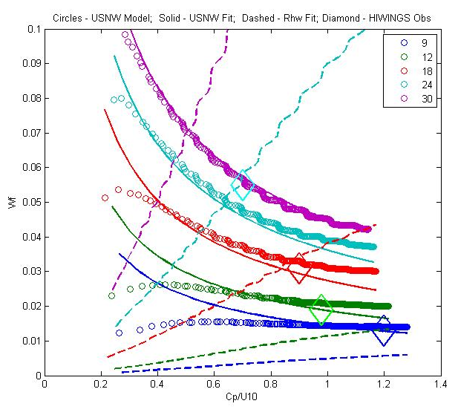
The Story of Two Whitecap Parameterizations
Wave Model C36
Empirical Fit to HIWINGS
Rhw Brummer
Circles – UNSW wave model at selected wind speeds
Solid Lines – C36 fit to circles
Dashed lines – Brummer Rhw fit

Slide 17
Wave vs Wind Speed
C_{d}(U) vs C_{d}(U,C_{p}, H_{s}) about the same correlation with direct observations
Whitecaps and k_{x}, better correlation with wave waveinform

Slide 18
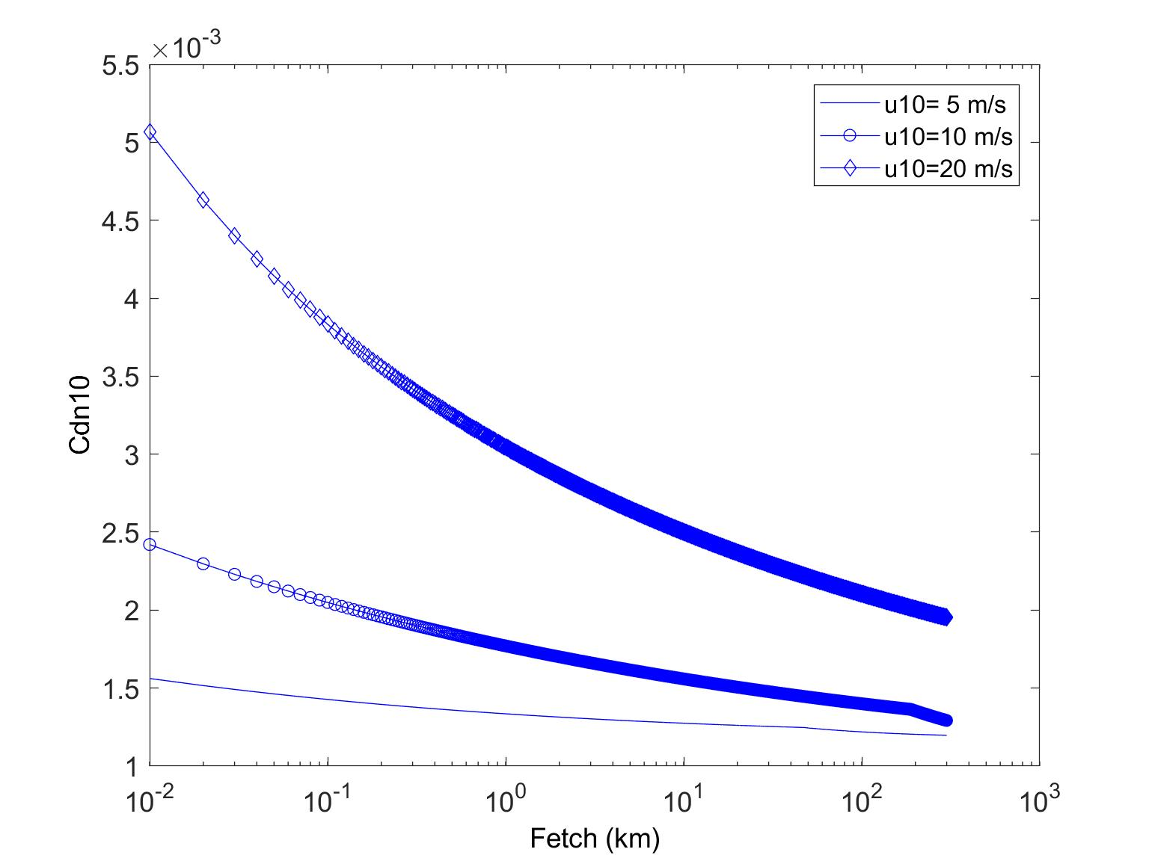
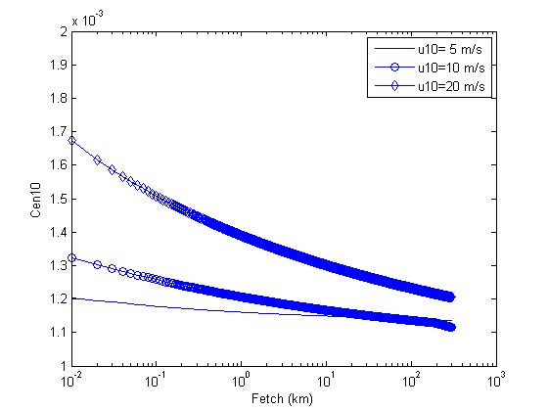
Fetch-limited Flow Regimes Lakes or Coastal

